Slide 1

title : - “ Online crime report system”

Slide 2

Project Supervisor
Dr. Sangeeta Arora
Team Members
Deepanshu – 2100290140056
Sagar Kumar – 2100290140115
Shivani Pandey – 2100290140130

Slide 3
INTRODUCTION
An online crime report system is a web-based platform that allows individuals to report crimes or suspicious activities to law enforcement agencies via the internet. This system provides a simple and convenient way for people to report crimes without the need to physically visit a police station.
The online crime report system typically requires users to provide information about the crime they are reporting, such as the location, time and date, and a description of the incident. Users may also be asked to provide personal information, such as their name and contact details, to enable law enforcement agencies to follow up on the report.
The benefits of an online crime report system include faster response times, increased efficiency, and improved communication between law enforcement agencies and the public. Additionally, it allows law enforcement agencies to better allocate their resources and prioritize cases based on the severity of the crime.
However, it is important to note that an online crime report system may not be suitable for all types of crimes, especially in cases where immediate intervention is required. Therefore, it is important to understand the limitations of such a system and to use it appropriately.

Slide 4
TECHNOLOGIES USED
FRONT END
HTML, CSS
Bootstrap
BACK END
Java
MySQL

Slide 5
SOFTWARE REQUIREMENTS
VS CODE
ECLIPSE
MySQL
Apache Tomcat v8.5

Slide 6
MINIMUM HARDWARE REQUIREMENT
Processor 11th Gen Intel(R) Core(TM) i3
System Type 64-bit operating system
Speed 3.00 GHz
Hard Disk Space 256 GB
Ram Memory 8 GB
Operating System Window 11

Slide 7
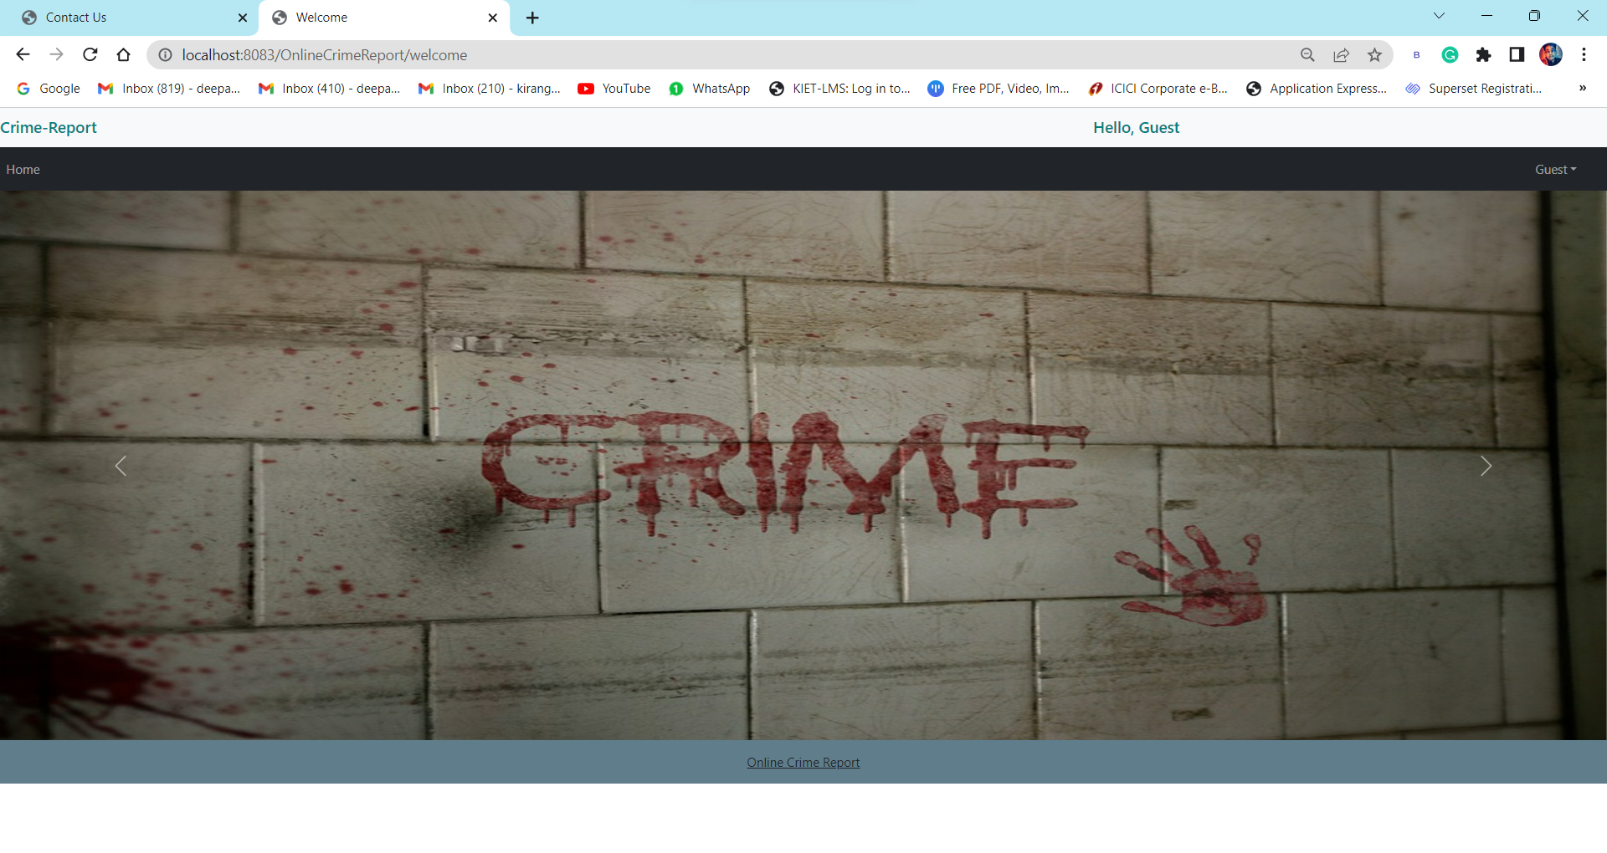
MODULES DESCRIPTION
Welcome Display
This is a first page of website that displays the welcome screen for the User & Admin.

Slide 8
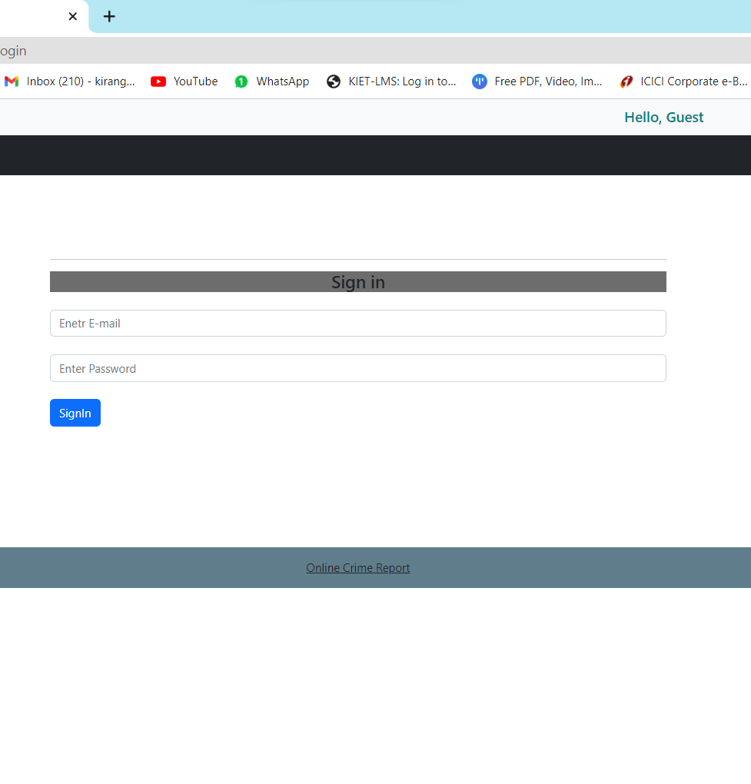
Login/Signin Module
This Page shows the Login name and password when user enter a valid user name and password then he/she can operate their account.

Slide 9
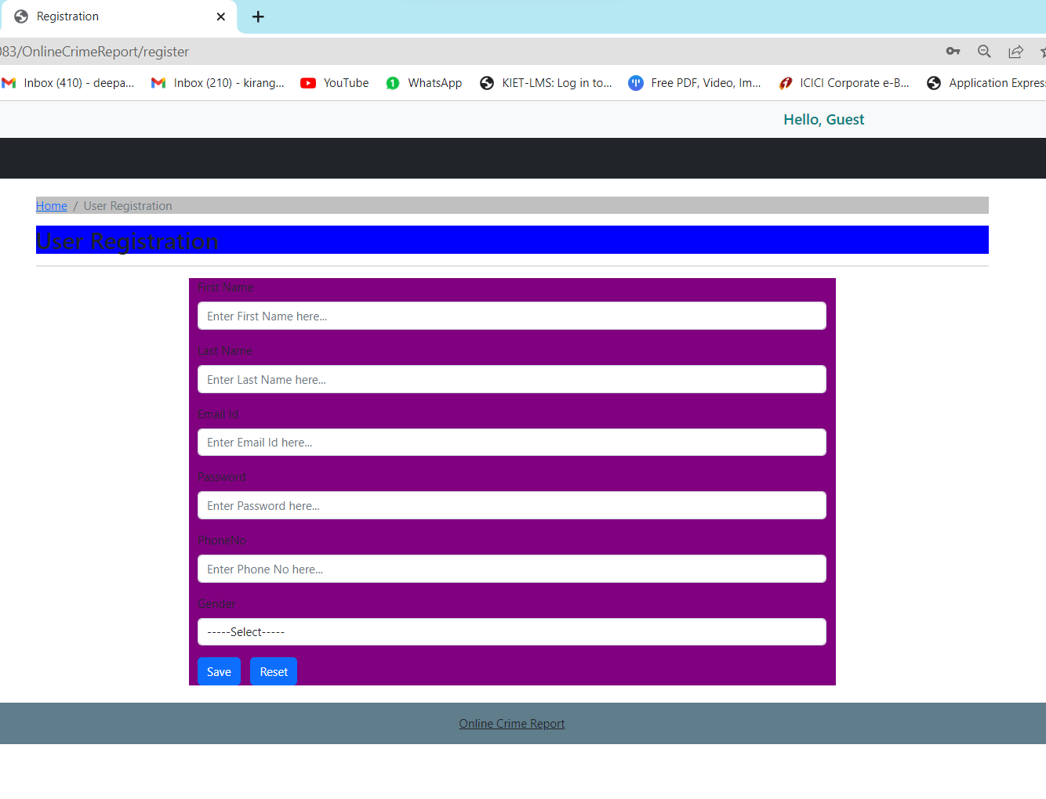
Register Module
This Page is a menu-based that displays the menu for register user details.

Slide 10
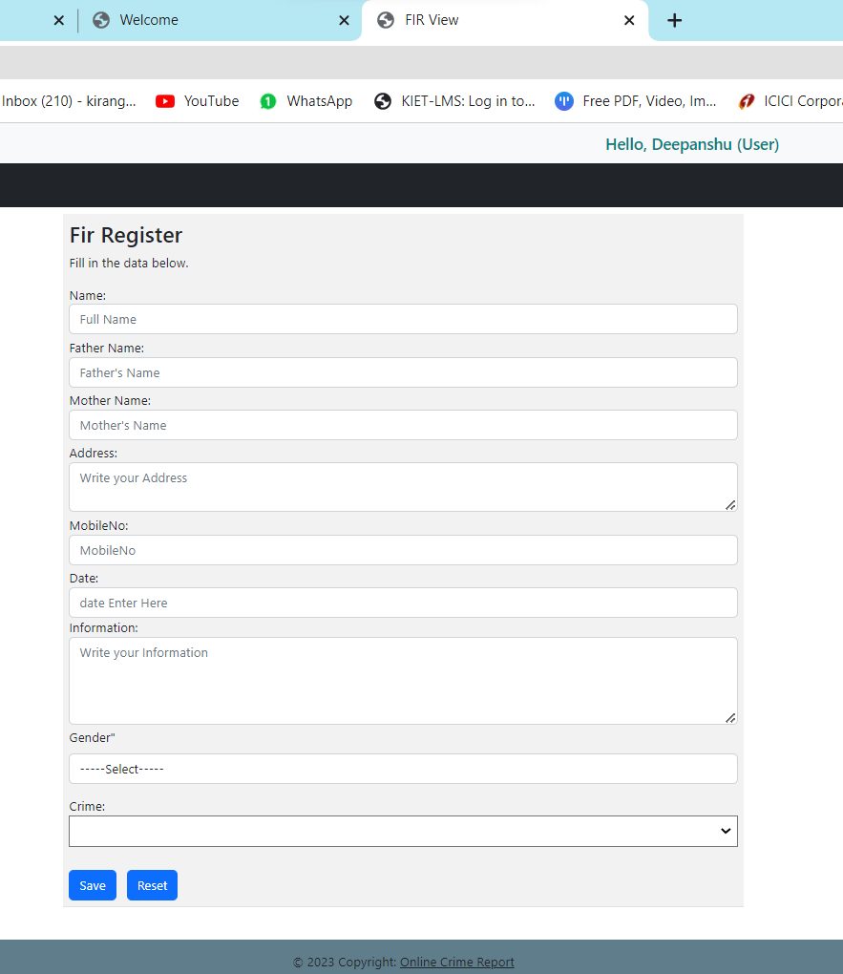
Fir Register Module
This Page is a menu-based that displays the menu for register Fir details.

Slide 11
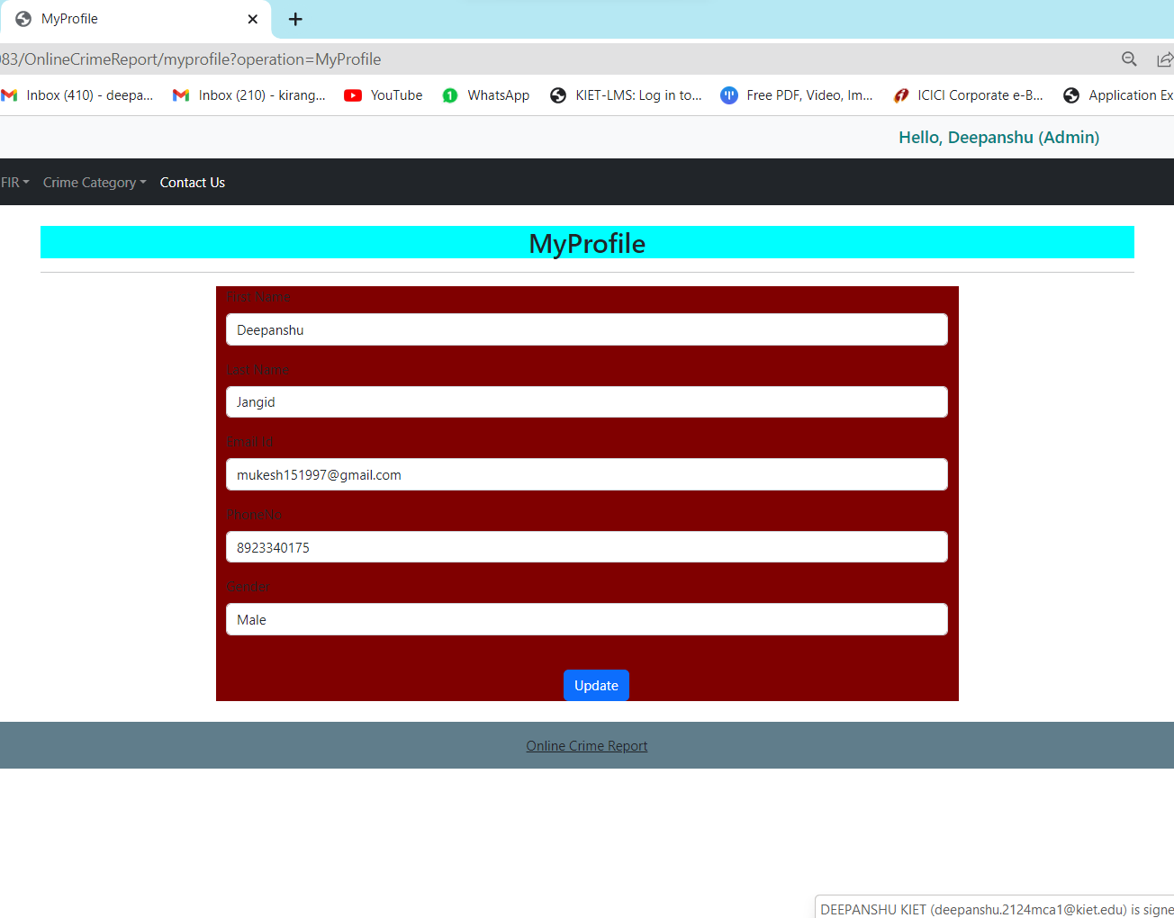
User Profile Module
This Page is a menu-based that displays the menu for operation of the website. It includes various options like edit profile, update profile, manage account related option.

Slide 12
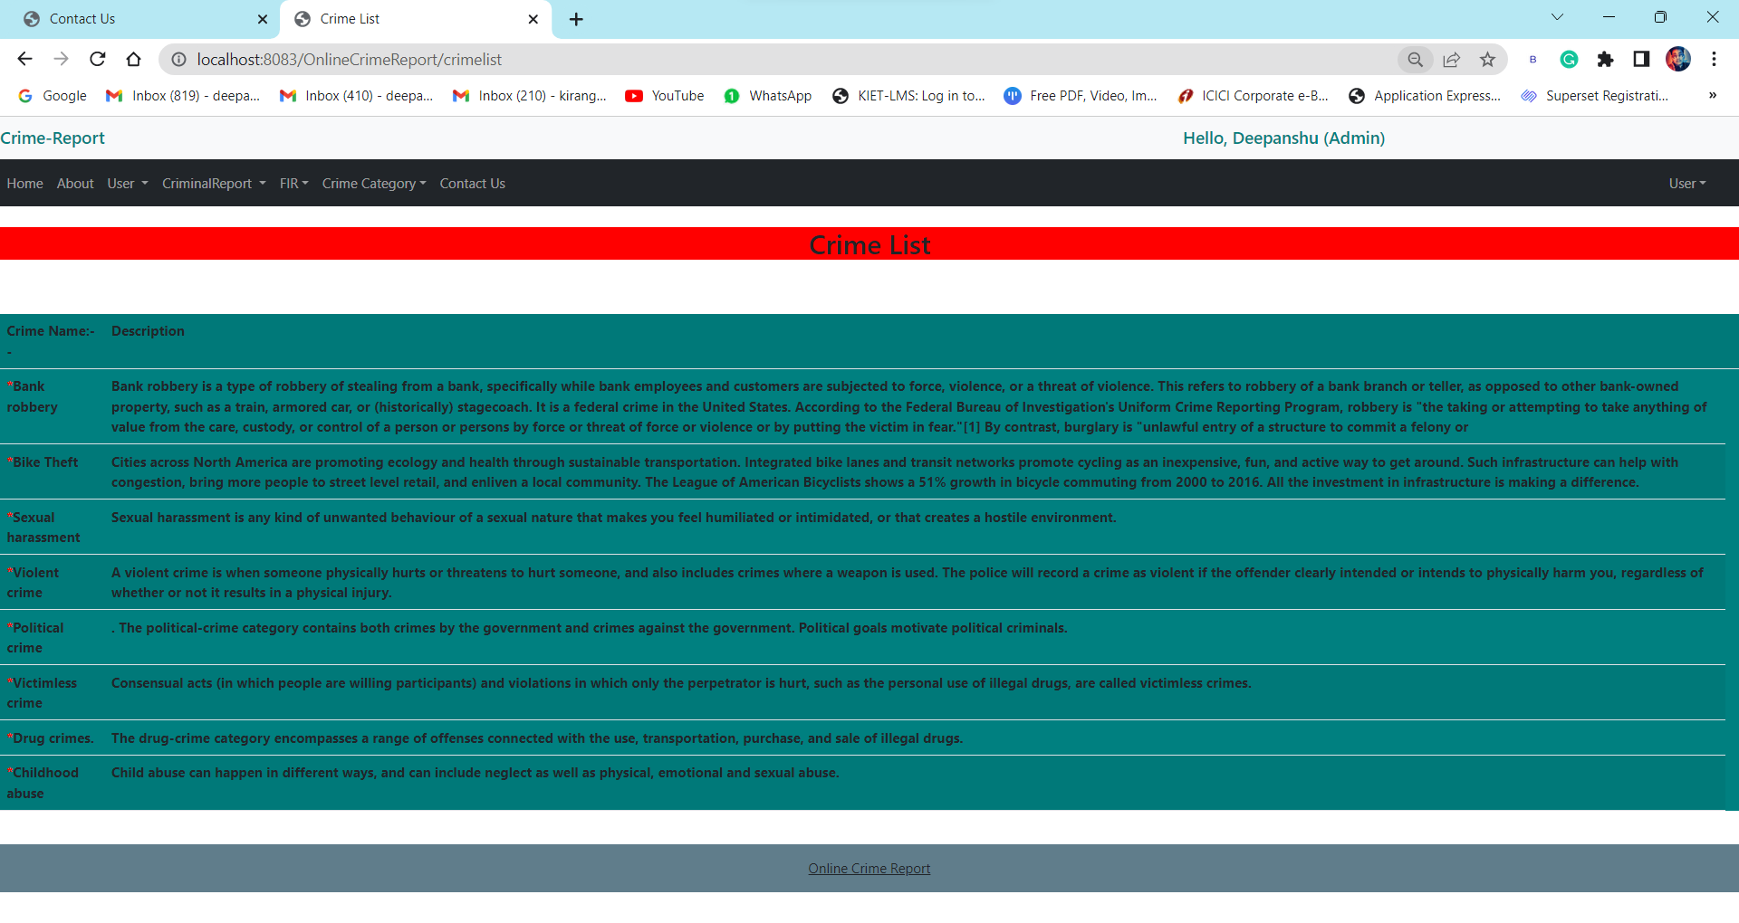
Crime List Module
This Page is display about different Crime List.

Slide 13
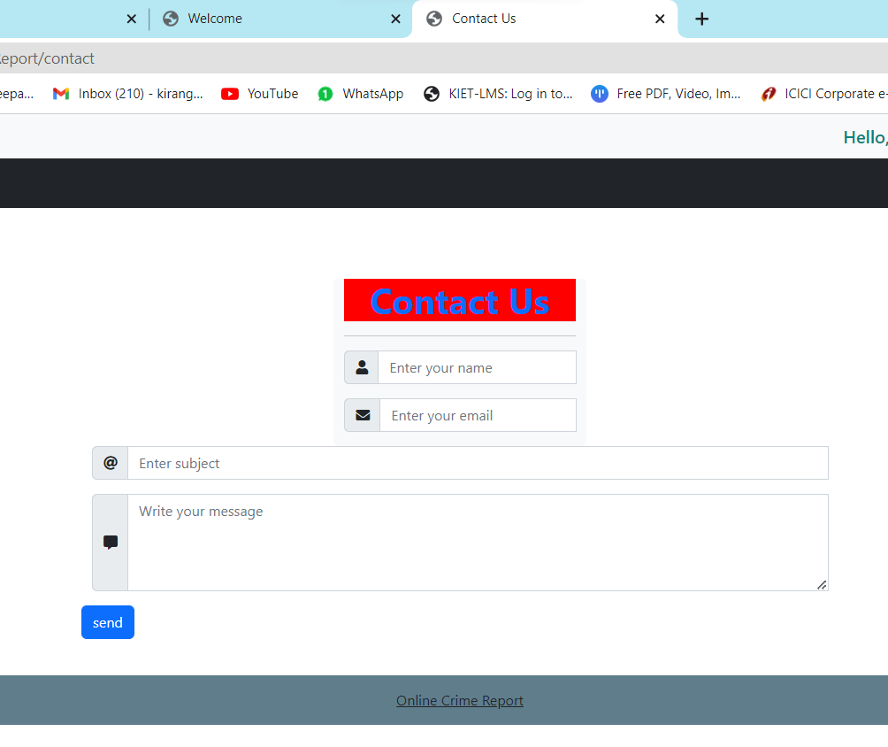
Contact US Module
User can contact us & give feedback according to their analyse.

Slide 14
REPORTS / OUTPUTS
The output of an online crime report system is typically in the form of a report that contains information about the crime that has been reported. The report may include details such as the location, time and date of the incident, a description of the crime, and the personal details of the person who reported it.
In addition to the report itself, the online crime report system may generate other outputs such as notifications to law enforcement agencies about the reported crime, alerts to relevant authorities or emergency services, and updates to the person who reported the crime about the status of their report.
The system may also generate statistics and other data that can be used to analyze crime trends and patterns, which can help law enforcement agencies to identify areas of high crime activity and allocate resources accordingly.
Overall, the output of an online crime report system is designed to provide a more efficient and effective way for people to report crimes and for law enforcement agencies to respond to them, ultimately leading to a safer and more secure community.

Slide 15
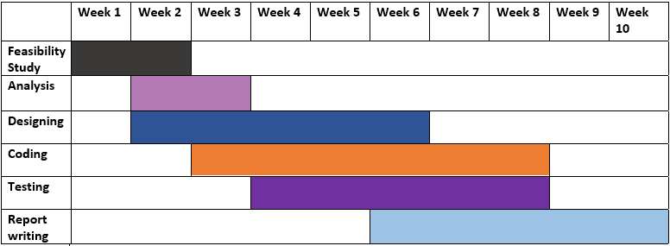

Slide 16


